Slide 1
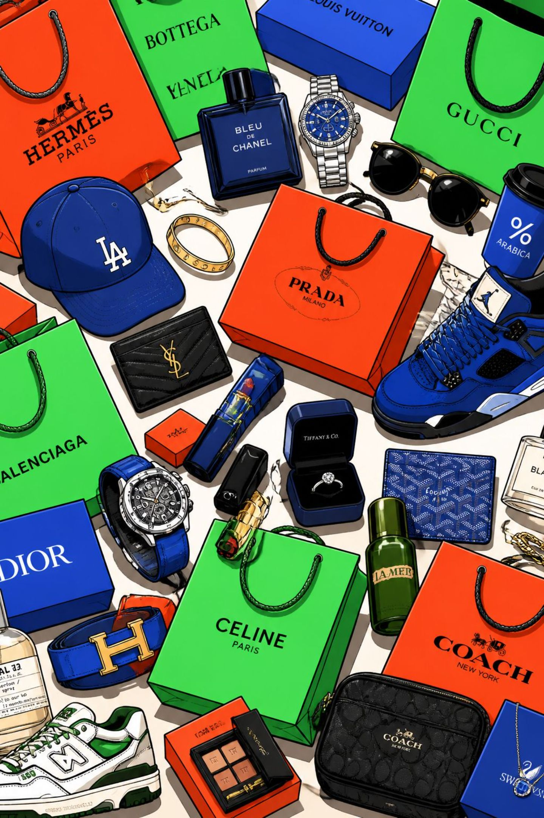
Customer Shopping Behavior Analysis
Uncovering spending patterns, customer segments, and product preferences across 3,900 transactions to guide strategic business decisions.

Slide 2

Dataset at a Glance
3,900
Transactions
Rows in dataset
18
Features
Columns per record
₹59.76
Avg Purchase
Mean spend per order
37
Missing Values
Review Rating column
Key features include demographics (Age, Gender, Location, Subscription Status), purchase details (Item, Category, Amount, Season, Size, Color), and shopping behavior (Discount Applied, Promo Code, Frequency, Review Rating, Shipping Type).

Slide 3



Python: Data Preparation
Loading & Exploration
Imported via pandas; used df.info() and .describe() for structure and summary stats.
Missing Data
Imputed 37 missing Review Ratings using the median rating per product category.
Feature Engineering
Created age_group (binned ages) and purchase_frequency_days. Dropped redundant promo_code_used.
Database Integration
Loaded cleaned DataFrame into PostgreSQL for SQL analysis.

Slide 4
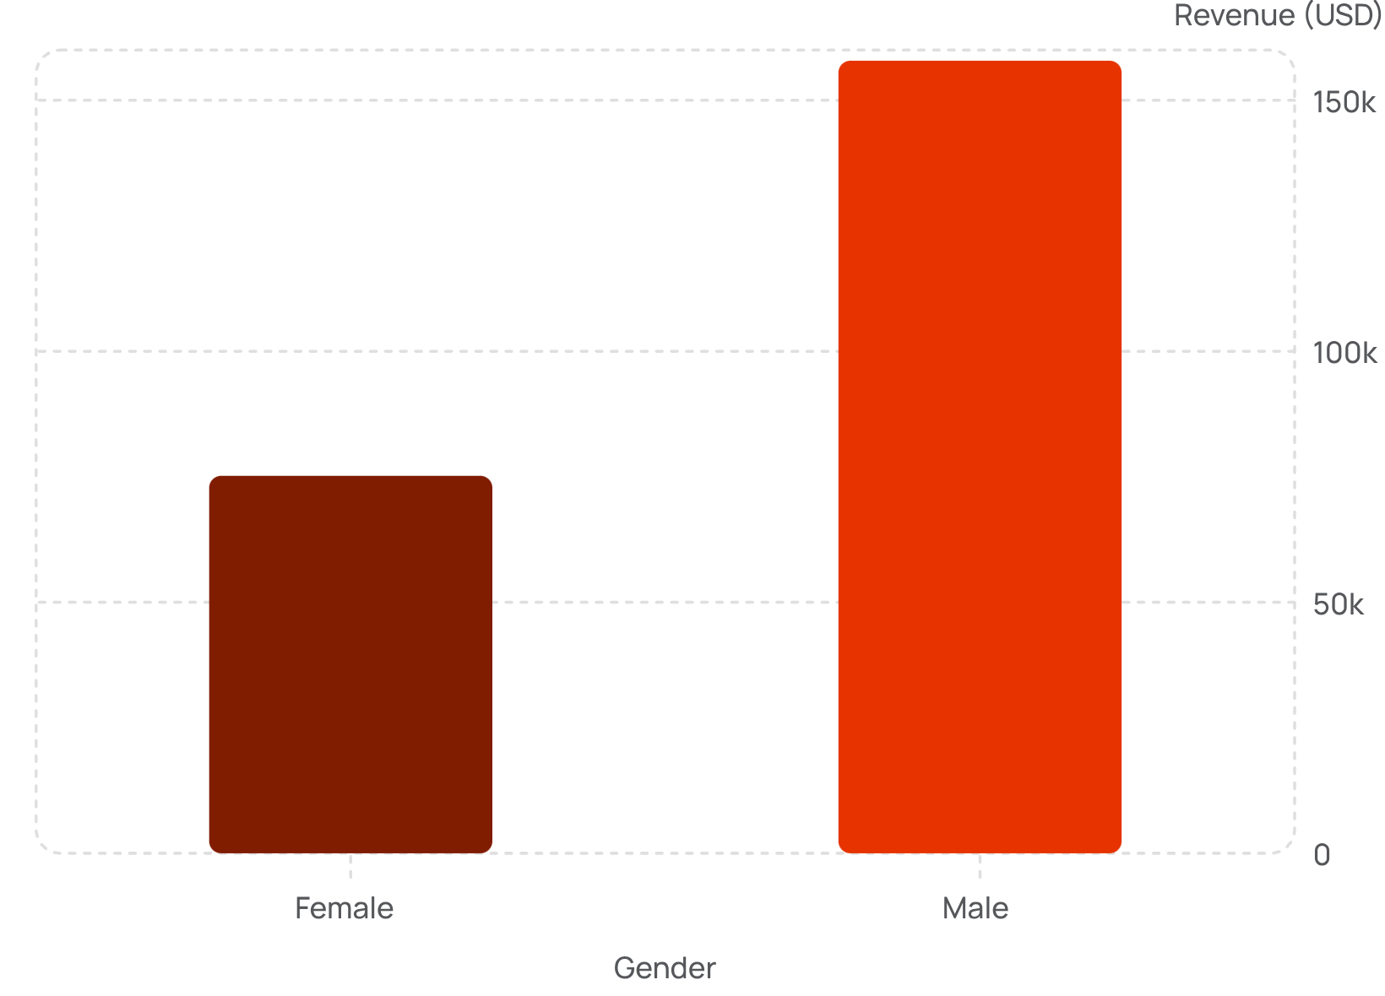

Revenue by Gender & Subscription
Key Findings
Male customers generated $157,890 in revenue — over double the $75,191 from female customers.
Non-subscribers (2,847 customers) contributed $170,436 total revenue vs. $62,645 from 1,053 subscribers, though average spend was nearly identical (~$59.50).
839 customers used discounts yet spent above the average purchase amount.

Slide 5
Top Products by Rating
🥇 Gloves
🥈 Sandals
🥉 Boots
Avg Rating: 3.86
Avg Rating: 3.84
Avg Rating: 3.82
Hat
Skirt
Avg Rating: 3.80
Avg Rating: 3.78
Express shipping averaged ₹60.48 vs. ₹58.46 for standard — a modest ₹2 premium.

Slide 6
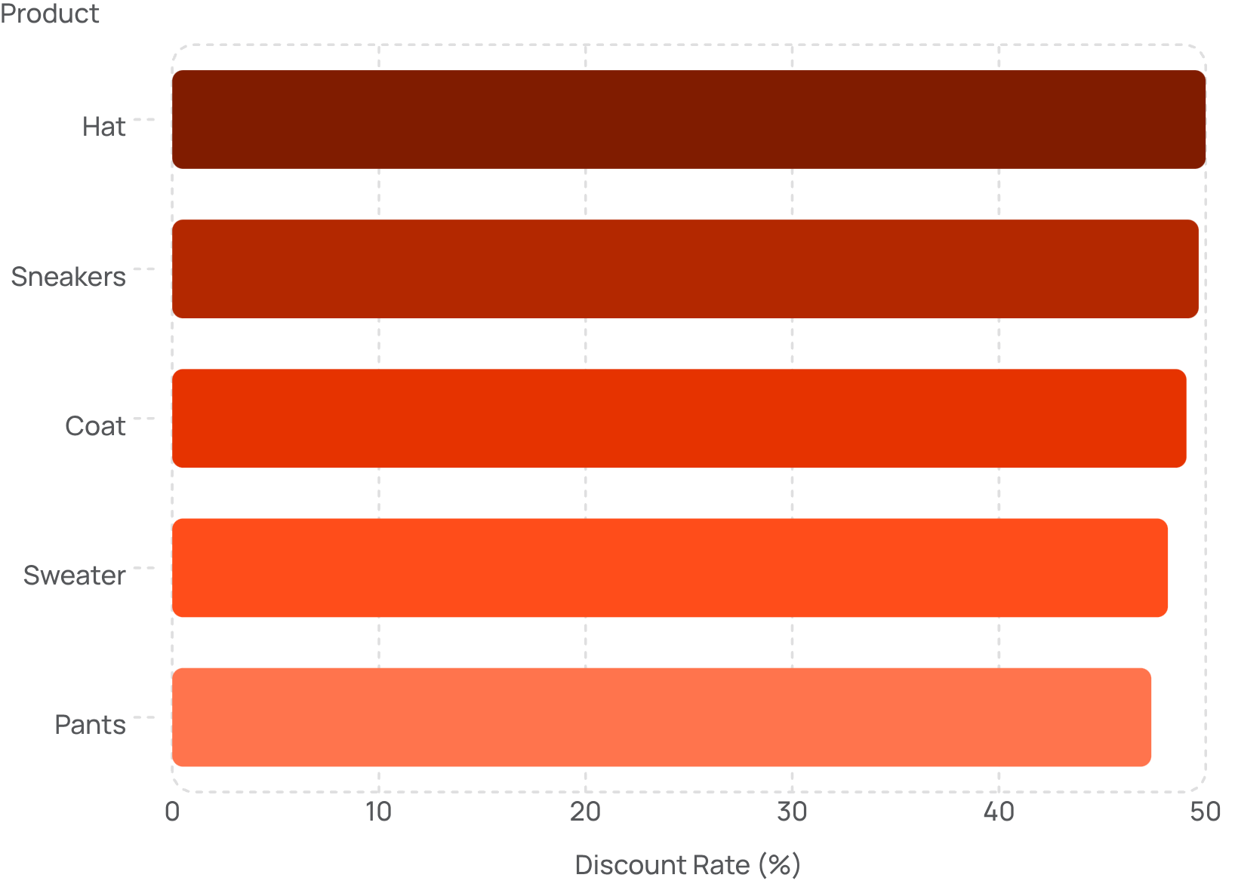
Discount-Dependent Products
These five products had the highest percentage of discounted purchases, indicating strong price sensitivity among buyers.
Hat — 50.00% discounted
Sneakers — 49.66% discounted
Coat — 49.07% discounted
Sweater — 48.17% discounted
Pants — 47.37% discounted

Slide 7
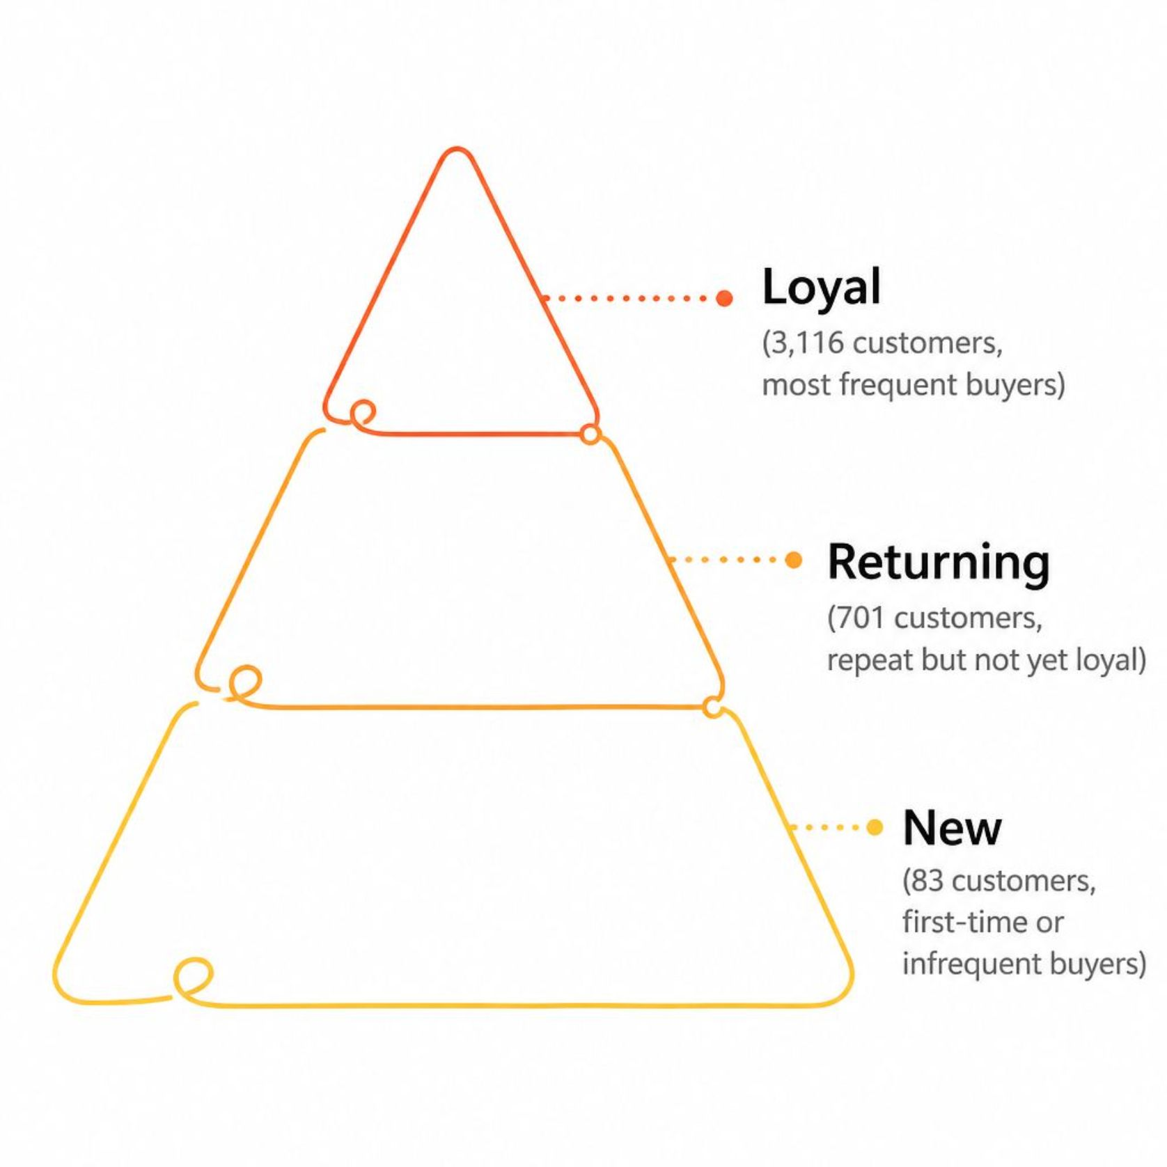
Customer Segmentation
Segment Breakdown
Customers were classified into three tiers based on purchase history:
Loyal: 3,116 customers — the dominant segment
Returning: 701 customers — repeat buyers not yet loyal
New: 83 customers — first-time or infrequent shoppers
Of repeat buyers (>5 purchases), 958 subscribed while 2,518 did not, suggesting subscription uptake remains an opportunity.

Slide 8

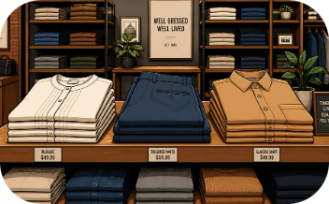
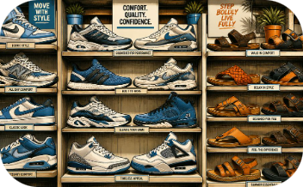
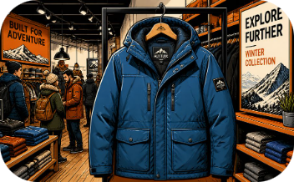
Top Products by Category
Accessories
Clothing
Footwear
Outerwear
Jewelry (171), Sunglasses (161), Belt (161)
Blouse (171), Pants (171), Shirt (169)
Sandals (160), Shoes (150), Sneakers (145)
Jacket (163), Coat (161)

Slide 9
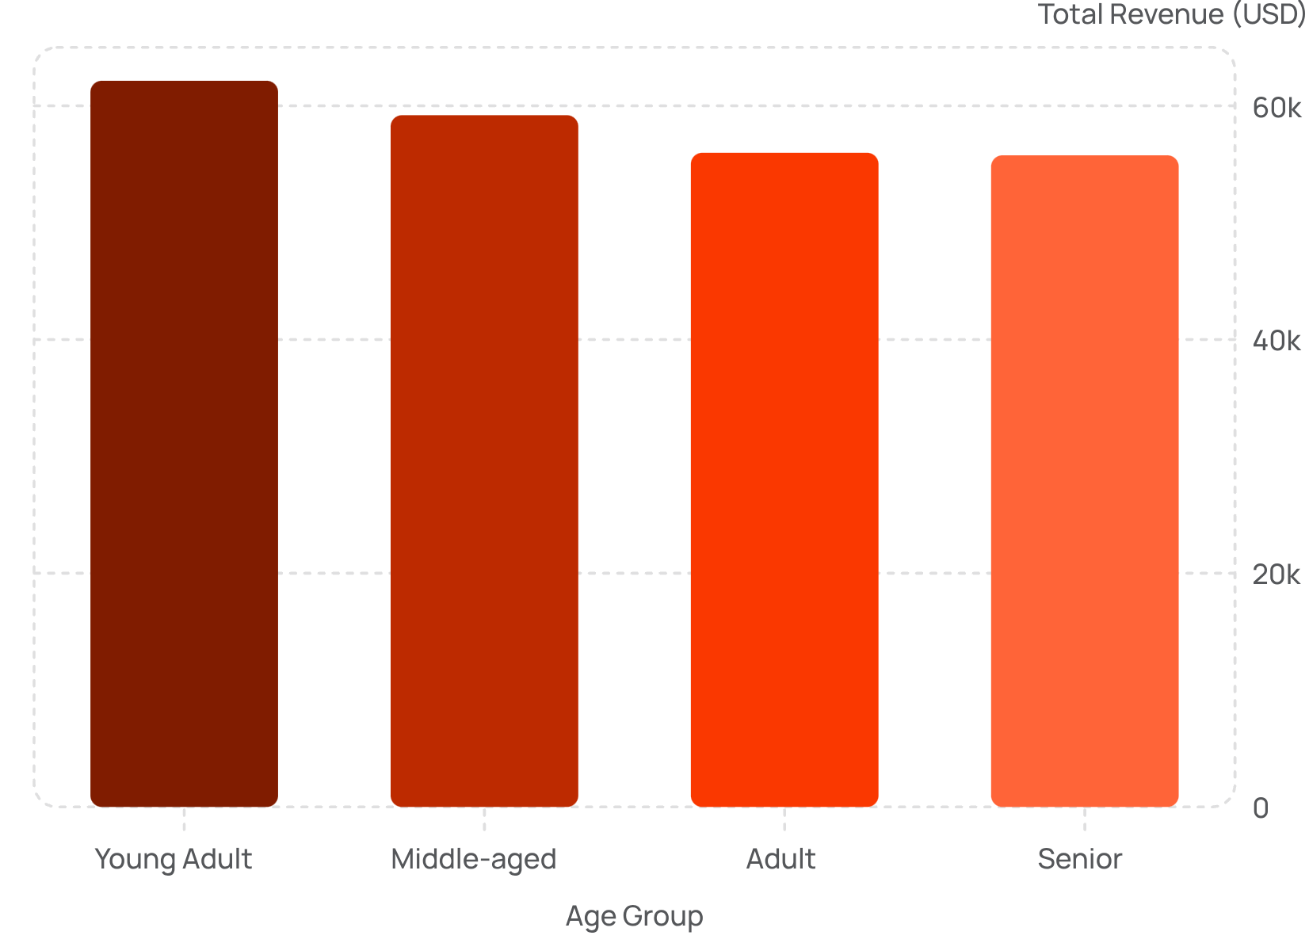
Revenue by Age Group
Age Group Insights
Young Adults lead revenue at $62,143, with a gradual decline across older groups. Revenue is relatively evenly distributed — no single age group dominates.
3.9K
3.75
Total Customers
Avg Review Rating

Slide 10





Business Recommendations
Boost Subscriptions
Loyalty Programs
Review Discount Policy
Promote exclusive subscriber benefits to convert the 73% non-subscribed base.
Reward repeat buyers to move them into the "Loyal" segment (currently 3,116 customers).
Balance sales boosts with margin control — nearly 50% of top products rely on discounts.
Targeted Marketing
Product Positioning
Focus on high-revenue age groups (Young Adults) and express-shipping users.
Highlight top-rated items (Gloves, Sandals, Boots) and best-sellers in campaigns.

